Slide 1
Life Cycle Profile Development for Product Reliability Validation
Abhishek Ram and Dr. Diganta Das (diganta@umd.edu)
Center for Advanced Life Cycle Engineering (CALCE)
University of Maryland, College Park
https://calce.umd.edu/
Presented to
Centre for Advances in Reliability and Safety (CAiRS) April 20, 2022 (Wednesday)

Slide 2

Abhishek Ram
Abhishek Ram is currently pursuing his M.S. in Mechanical Engineering at the University of Maryland (UMD), where he is also the president of the IPC Chapter at UMD. He completed his B.S. in Mechanical Engineering with a minor in Applied Mathematics at the University of Massachusetts, Amherst, in December 2019.
Abhishek is working with Dr. Diganta Das for his Master’s thesis. His research focuses on developing qualification testing and screening procedures for electronic components, including insulated gate bipolar transistors. Abhishek’s research also includes applications of prognostics and diagnostics techniques to supplement existing qualification practices.

Slide 3
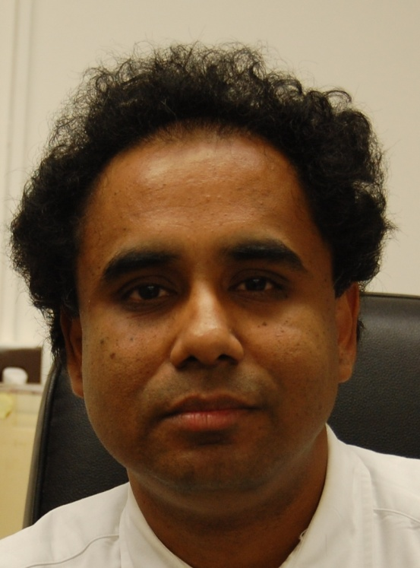
Dr. Diganta Das
Dr. Diganta Das (Ph.D., Mechanical Engineering, University of Maryland, College Park, B.Tech (Hons), Manufacturing Science and Engineering, Indian Institute of Technology) is an Associate Research Scientist at the Center for Advanced Life Cycle Engineering. His expertise is in reliability, environmental and operational ratings of electronic parts, uprating, electronic part reprocessing, counterfeit electronics, technology trends in the electronic parts, and parts selection and management methodologies. He performs benchmarking processes and organizations of electronics companies for parts selection and management, and reliability practices.
His current research interests include electronic parts supply chain, counterfeit electronics avoidance and detection, light-emitting diode failure mechanisms, and power electronics reliability. In addition, Dr. Das is involved in prognostics-based risk mitigation of electronics. Dr. Das has published more than 75 articles on these subjects and presented his research at international conferences and workshops.
Dr. Das leads the Educational Outreach of CALCE to develop inter-organizational agreements on joint educational programs, training and internship programs, and professional development. He had been an Associate Editor of the journal Microelectronics Reliability. He is a Six Sigma Black Belt and a member of IEEE, IMAPS, and SMTA.

Slide 4
The information provided in this presentation has been compiled by the
University of Maryland
Replication rights of all information is retained by individual presenters, their respective organizations, and CALCE. Reproduction or distribution of either printed or electronic versions of this material in whole or in part is strictly prohibited, with the sole exception of distribution to registered attendees by the meeting organizers at CAIRS - Centre for Advances in Reliability and Safety .
Copyright CALCE and the University of Maryland. All rights reserved.

Slide 5
Presentation Abstract
A key component of performing reliability assessment or planning for prognostics is understanding the stresses a product endures during its life. Many product failures are due to an incomplete understanding of the loads and stresses. This first step in product development makes achieving reliability goals possible.
The life cycle profile accounts for the expected loads a product undergoes across its lifetime. Developing this profile aims to get an overall view of the stresses the product will experience. Understanding the life cycle profile and the most significant loads informs the critical failure mechanisms for the product in the intended application and provides insight on improving product design. This presentation discusses the procedure for developing a life cycle profile based on requirements set for product reliability validation. This presentation also includes examples for completing and accounting for each aspect of this procedure.
This presentation describes an approach for identifying individual life cycle phases and steps that make up the whole life cycle. This presentation illustrates how variations in the life cycle profile might arise and how best to address and account for those variations to complete product reliability validation. Lastly, the presentation explains how to identify the loads a product might experience in its intended lifetime. It provides examples of loads that the product might experience.
The loads that a product undergoes may be estimated numerically, qualitatively categorized, or estimated via cycle counting, and the presentation provides methodologies for conducting these estimations. One then uses these estimates to model loading in the form of a loading cycle, and the presentation discusses methodologies for generating these cycles. The presentation demonstrates how to account for uncertainty in load estimates and variability in loading applied within every life cycle step.
With the life cycle profile identified for a product, the presentation demonstrates applying this knowledge to identifying critical failure mechanisms. The presentation discusses how the critical failure mechanisms and the life cycle profile apply to improve product design to satisfy the product’s reliability requirements and ability to withstand the intended application.

Slide 6
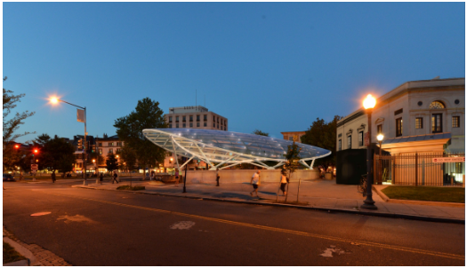
Canopies are Improving Metro Escalator Reliability
Washington DC area Metro system has been adding canopies on top of the escalators at its subway stations to protect the escalators from the effects of precipitation.
Before these changes, the ends of the escalators were fully exposed to the elements, resulting in poor reliability and high downtime.
Metro to begin escalator canopy installation at Dupont Circle Station’s north entrance this spring, Washington D.C., USA: Washington Metropolitan Area Transit Authority, 2019.
URL: https://www.wmata.com/about/news/Dupont-canopy-announcement.cfm

Slide 7






The Product Life Cycle Profile
Example of life cycle profile loads
The product life cycle profile is a catalog of the expected loads (environmental and due to product operation) a product will undergo over its lifetime.
Solar Radiation
Temperature
Rain
Acceleration
Pollution
Power Inputs

Slide 8
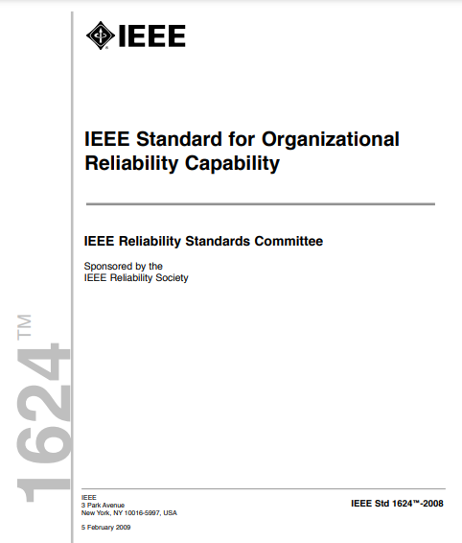
Reliability Program as per IEEE 1624: Standard for Organizational Reliability Capability
IEEE 1624 defines a reliability program as the collection of an organization’s practices to ensure a particular product’s reliability requirements are satisfied.
IEEE, IEEE 1624: Standard for Organizational Reliability Capability, New York City, New York: IEEE, 2008.

Slide 9
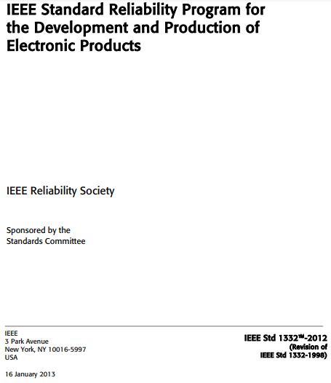
Reliability Requirements as per IEEE 1332
IEEE 1332 states the minimum reliability requirements a reliability program should include are:
Functionality: performance characteristics that are verifiable
Duration: expected/desired item lifetime or expected/desired mission time.
Reliability metrics: objective measure of reliability performance and durability over the life of the item
Life-cycle conditions: conditions of transport, storage, testing, handling, maintenance, and operation, plus use profiles (e.g., time and stress in each condition)
IEEE. IEEE 1332: Standard Reliability Program for the Development and Production of Electronic Products, New York City, NY: IEEE, 2013.

Slide 10
Presentation Objectives
How to develop a life cycle profile for a product’s intended operation and how to use it for product reliability validation.
This life cycle profile development procedure will consider the product’s
characteristics,
manufacturing procedure,
storage and transportation over its lifetime,
final intended application, and
possible variations of each aspect therein
How to use the life cycle profile to identify critical failure mechanisms and improve product design.

Slide 11
Overview of Life Cycle Profile Development (LCP) (1/2)
Begin with determining the part or product.
Identify the life cycle phase
Using the life cycle profile phases, identify the life cycle steps within a phase.
For each life cycle step and phase, gather the standards and procedures for completing them and identify possible variations that could arise over the lifetime of different products.
Identify the Product for which to Create LCP
Identify the Product’s LCP Phases
Validate LCP Phases and Assemble Team of Experts
Create Lists of LCP Steps in Each LCP Phase
Gather Standards and Procedures for Each LCP Step
Identify Possible Variations in LCP Phases and Steps
Identifying and Characterizing Stresses in LCP Steps
Modeling Load Cycling Throughout the LCP

Slide 12
Overview of Life Cycle Profile Development (LCP) (1/2)
Identify and characterize life cycle profile stresses throughout the product lifetime beginning with identifying the expected loads during the intended application.
The loads could be numerical point estimates, qualitative characterizations, or via cycle counting of the loads from measured data.
With these estimates, model the effects of these loads.
Identify the Product for which to Create LCP
Identify the Product’s LCP Phases
Validate LCP Phases and Assemble Team of Experts
Create Lists of LCP Steps in Each LCP Phase
Gather Standards and Procedures for Each LCP Step
Identify Possible Variations in LCP Phases and Steps
Identifying and Characterizing Stresses in LCP Steps
Modeling Load Cycling Throughout the LCP

Slide 13
Definitions Related to the Life Cycle Profile
Life cycle phase: Different periods of the product lifetime. Some examples of life cycle phases could include:
Period of operation
Manufacture of a product subassembly
Storage and transportation of product
…
Life cycle step: a single event or procedure within a life cycle phase.

Slide 14
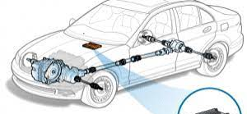
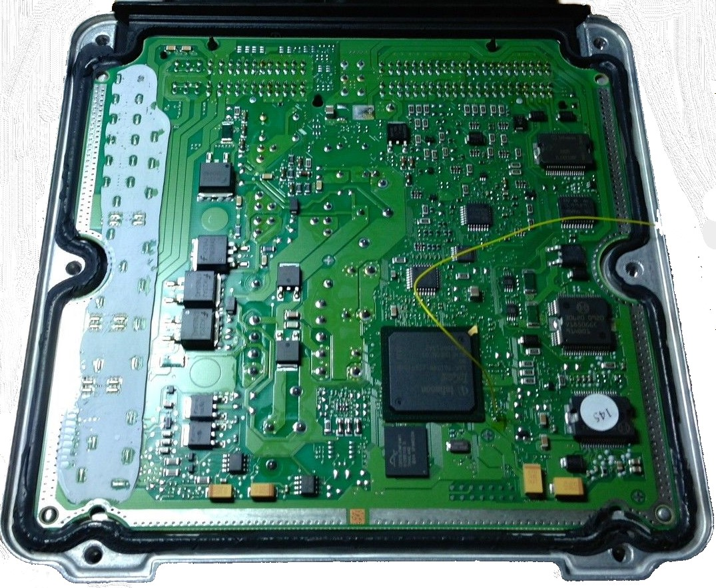
Life Cycle Profile Phases and Steps Example: Engine Control Module
Engine Control Module Storage, Transportation, and Engine Assembly
Engine Storage, Transportation, and Truck Assembly
A
B
C
D
E
F
G
H
I
A: Storage in Automotive Electronic Module Manufacturing Facility
E: Post Engine Assembly Storage
Example of an Engine Control Module
F: Transportation to Truck Assembly Facility
B: Air Transportation to Engine Manufacturing Facility
G: Storage in Truck Assembly Facility
C: Storage in Engine Manufacturing Facility
H: Assembling Engine Unit into Truck
D: Engine Unit Assembly and Cleaning
I: Post Truck Assembly Storage

Slide 15
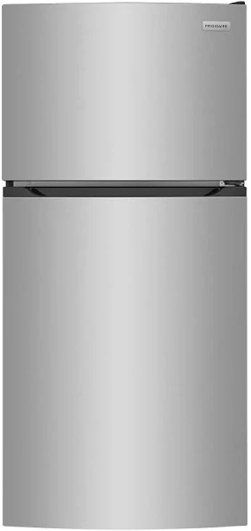
Life Cycle Profile Phases and Steps Example: Refrigerator Compressor During Operation
Refrigerator Installation
Refrigerator Pull-Down
If the power goes out
Compressor Start Up
Compressor Idle
Compressor Running
Compressor Turn Off

Slide 16
Possible Variations in Life Cycle Profile Steps
Each life cycle phase or step could have different variations over the lifetime of different manufactured products.
It is crucial to catalog potential variations in the life cycle profile phases and steps to ensure that the developed life cycle profile accounts for all potential loads.
From the potential variations, determine which variations are most impactful to product performance and reliability.

Slide 17
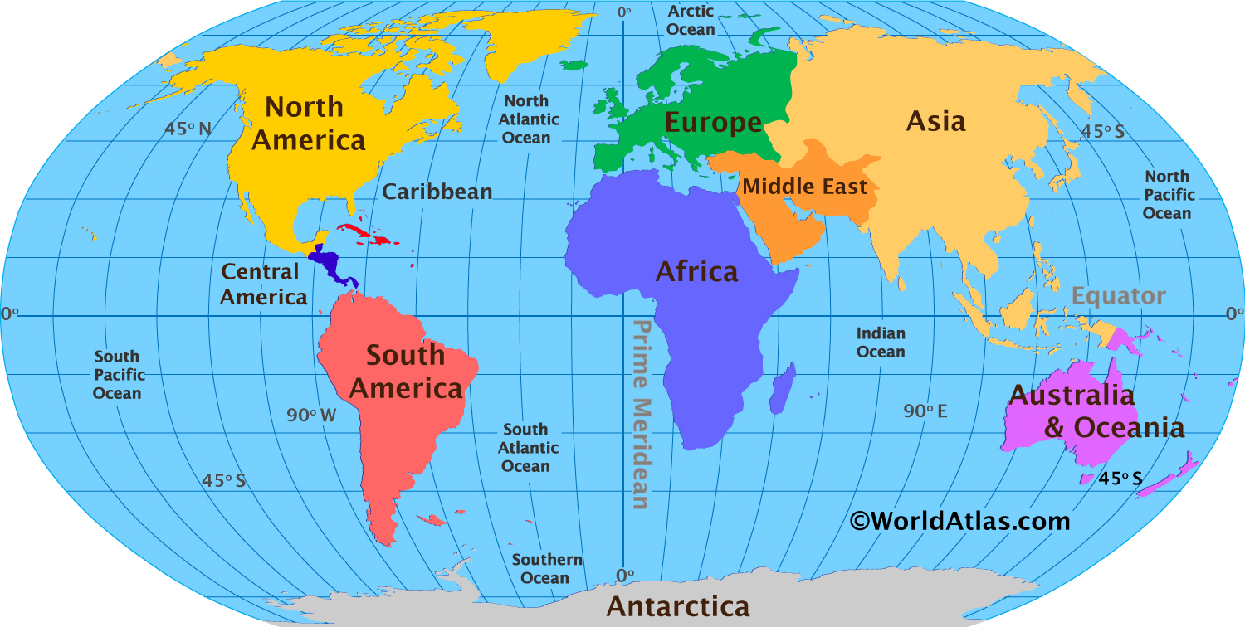
Example of Life Cycle Variations: Different Locations for Life Cycle Profile Phases
Product Manufacturing Location (a type of product may be manufactured in more than one place)
Product Assembly into Final Product
Area of Operation
Storage or Transportation Procedure

Slide 18



Example of Life Cycle Variations: Different Product Storage and Transportation Procedures
Product Manufacturing Location (a type of product may be manufactured in more than one place)
Product Assembly into Final Product
Area of Operation
Storage or Transportation Procedure
Modes of Product Transportation

Slide 19
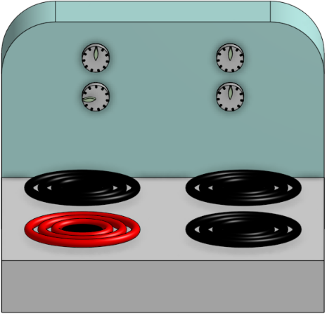
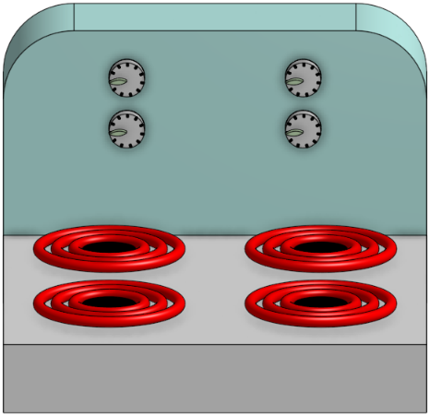
Example of Life Cycle Variations: Stovetop Modes of Product Operation
Each stovetop / hob coil can be heated to different levels
Every coil can also be turned on simultaneously

Slide 20
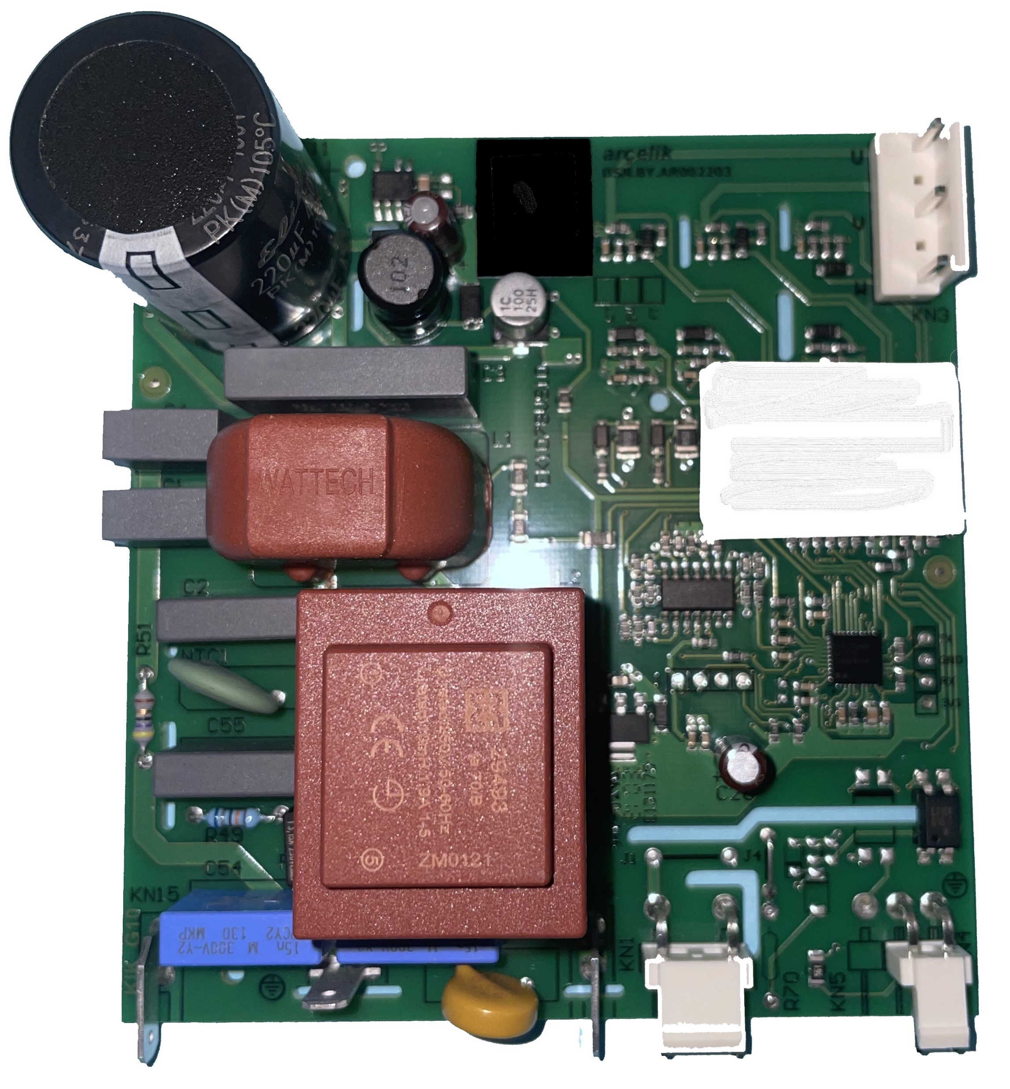
Example of Life Cycle Variations: Product Rework During Manufacturing and Assembly
Example of Rework
Iron temperature: 400°C
Contact made with solder joint for 5 seconds
Even if one tries to protect surrounding components from thermal effects, the thermal shock caused by rework to the vicinity of the rework locations (circled) is nontrivial.
Sample Rework Locations

Slide 21
Identifying and Characterizing Life Cycle Profile Loads
United States Department of Defense Military Standard (MIL-STD) 810 lists several potential sources of loading that a product could undergo during its lifetime.
Three example methods for characterizing loads that a product could experience include:
Numerical estimation
Qualitative categorization
Cycle-counting estimation
U.S. Department of Defense, MIL-STD-810: Environmental Engineering Considerations [Standard], Department of Defense, 2019.

Slide 22
Numerical Estimation of Expected Life Cycle Loads
Numerical estimates of expected life cycle profile conditions are point estimates of the loads that a product experiences.
Numerical point estimates of life cycle loads can come from multiple sources, including:
simulation of operation
historical weather data
operation parameters
standards and procedures for completing a manufacturing step
…

Slide 23
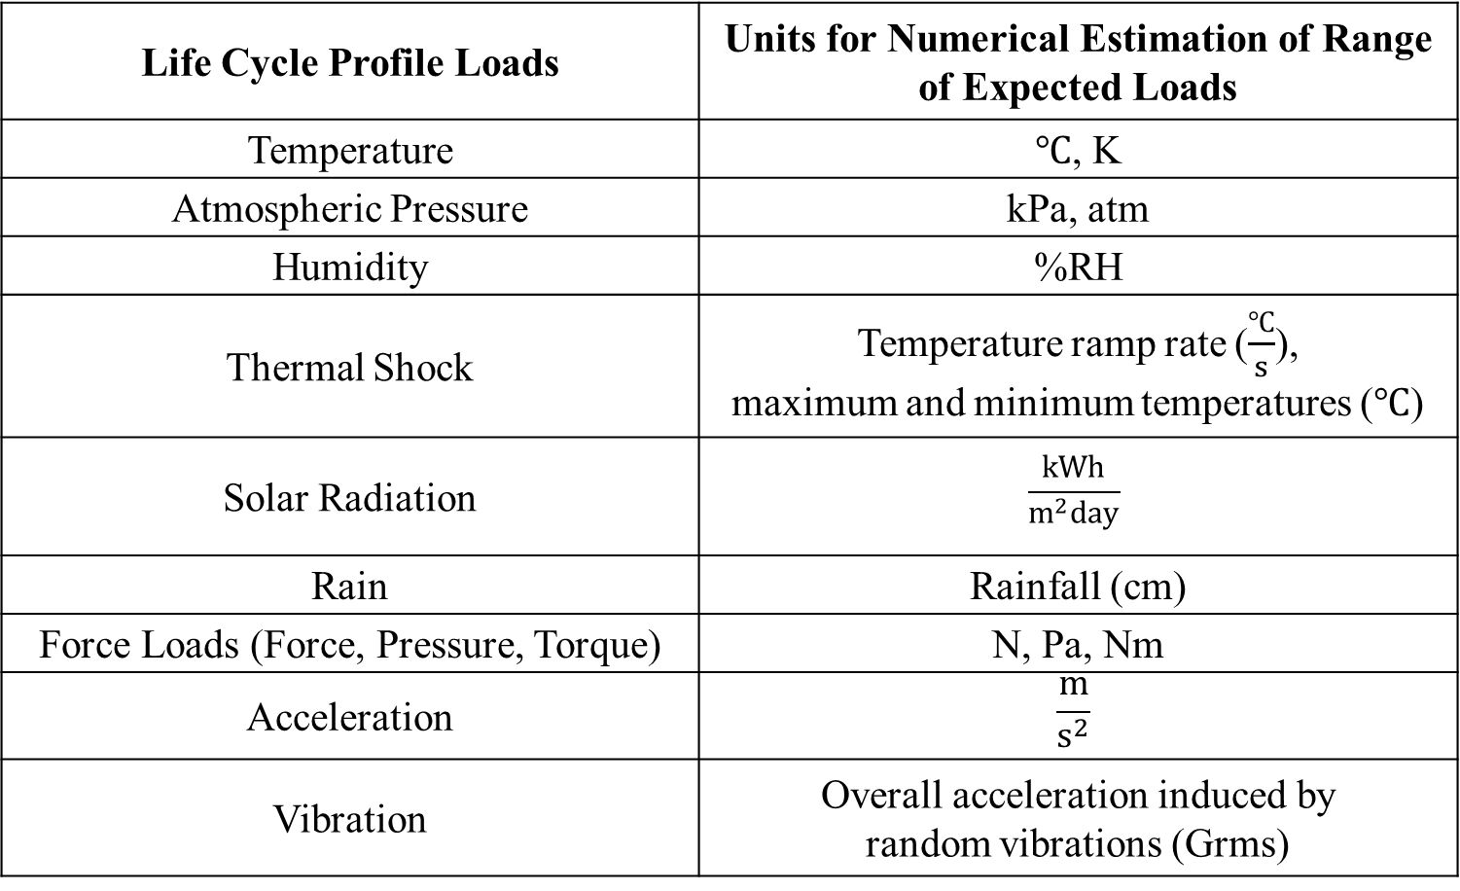
Numerically Estimable Life Cycle Profile Loads
Life Cycle Profile Loads | Units for Numerical Estimation of Range of Expected Loads
Temperature | $℃$, K
Atmospheric Pressure | kPa, atm
Humidity | %RH
Thermal Shock | Temperature ramp rate ($\frac{℃}{s}$), maximum and minimum temperatures ($℃$)
Solar Radiation | $$\frac{kWh}{m^{2}day}$$
Rain | Rainfall (cm)
Force Loads (Force, Pressure, Torque) | N, Pa, Nm
Acceleration | $$\frac{m}{s^{2}}$$
Vibration | Overall acceleration induced by random vibrations (Grms)

Slide 24
Example of Numerical Estimation of Expected Life Cycle Loads: Solder Reflow Profile
Example of the reflow profile included in J-STD-020 (not to scale).
This idealized solder reflow profile is a numerical estimation of the actual reflow profile the product undergoes during manufacturing.
Temperature
Maximum Temperature
Temperature
Time-to-Peak
Liquidus Temperature
Cooling
Maximum Temperature
Ramp to Peak
Liquidus Temperature
Preheat / Soak
Reflow
Time
Preheat / Soak
Ramp to Soak
Time
J-STD-020: Moisture/Reflow Sensitivity Classification for Nonhermetic Surface Devices [Standard], Arlington, VA: Joint Electron Device Engineering Council (JEDEC), 2014.
Ramp to Soak
Ramp to Peak
Reflow
Cooling

Slide 25
Example of Numerical Estimation of Expected Life Cycle Loads: Solder Reflow Profile
Temperature
Some products could:
Experience multiple exposures to solder reflow
Undergo rework
Have already experienced reflow at a prior discarded assembly
As a result, one cannot ignore life cycle steps like these, even though they are short in duration compared to the product lifetime and occur before product shipment.
Time-to-Peak
Maximum Temperature
Liquidus Temperature
Preheat / Soak
Time
Ramp to Soak
Ramp to Peak
Cooling
Reflow

Slide 26
Example of Numerical Estimation of Expected Life Cycle Loads: Solder Reflow Profile
Temperature
Time-to-Peak
Maximum Temperature: 245 °C
Liquid Temperature: 220 °C
Maximum Ramp-Up Rate: 3.0 °C/s
Time Above Liquidus: 75-90 s
Maximum Ramp-Down Rate: 3.0 °C/s
Time-to-Peak: 6.0 s
Maximum Temperature
Liquidus Temperature
Preheat / Soak
Time
Ramp to Soak
Ramp to Peak
Cooling
Reflow

Slide 27
Qualitative Categorizations of Life Cycle Loads
Qualitative categorization applies where the expected life cycle conditions are not point-estimable with high confidence.
Interval estimates of operating environments characterize the likelihood of different operating conditions as being “low,” “medium,” or “high.”
The life cycle profile ignores low-categorized conditions, and life cycle condition estimates use the lower bound conditions of the medium and high-categories.
For extreme life cycle conditions, one can assume that there is a longer duration / more cycles of high-category conditions.

Slide 28
Example Categorizations of Life Cycle Load Ranges
Condition Type (names taken from MIL-STD 810) | Condition Qualification | Low | Medium | High
Fluid Contamination | The product is exposed to the fluid contaminants for “XX” time. | <5 min | 5 min – 3 hr | >3 hr
Freeze / Thaw | The temperature reaches both below freezing and above freezing temperatures “XX%” of the year. | <5% | Between 5-10% | >10%
Salt Fog | The product is exposed to a “XX” %/hr salt fog. | 0 % / hr | 0-5% / hr | > 5% / hr
Sand / Dust | The effect of dust is based on the effect of “XX” % RH and how it relates to the critical relative humidity (CRH) for the dust in the environment in each life cycle profile step. | < 0.75 * CRH | Between 0.75*CRH and CRH | > CRH
U.S. Department of Defense, MIL-STD-810: Environmental Engineering Considerations [Standard], Department of Defense, 2019.
The condition ranges for sand dust come from: B. Song, Impact of Dust on the Reliability of Printed Circuit Assemblies [PhD Dissertation], College Park, Maryland: University of Maryland, College Park, 2012.

Slide 29
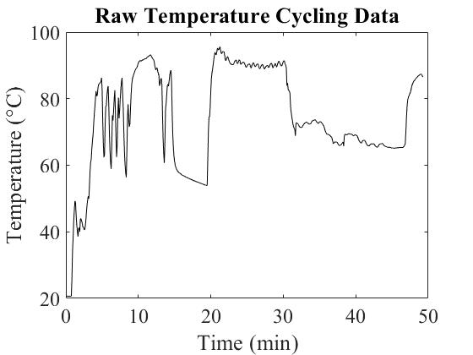
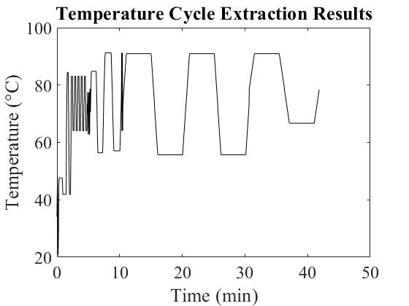
Cycle-Counting Estimation of Life Cycle Loads
Numerical estimates and qualitative categorizations of life cycle conditions are based on empirical estimates.
However, with obtained data from testing or environmental monitoring, one can identify examples of loading cycles the product experiences.
Cycle-counting algorithms identify individual cycles within raw data.

Slide 30
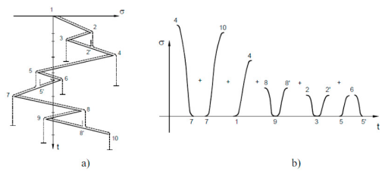
Example of Cycle Counting: Rainflow Counting Algorithm
Initially developed by Matsuishi and Endo in 1968, the rainflow counting algorithm takes a time history of a loading input and separates it into multiple unique cycles.
An example of the rainflow counting cycle on a time history of loading input. a) is the rotated loading time history for the product, and b) is the equivalent loading time history when separated into the individual cycles.
M. Matsuishi and T. Endo, “Fatigue of Metals Subjected to Varying Stress,” in Japan Society of Mechanical Engineers, Fukuoka, Japan, 1968.
Rainflow algorithm example taken from D. Ribeiro, R. Calçada and R. Delgado, "Fatigue of Metallic Railway Bridges: Implementation of a Methodology of Analysis and Application to the Alcácer do Sal Bridge," in The Third International Conference on Bridge Maintenance, Safety and Management, Porto, Portugal, 2006.

Slide 31
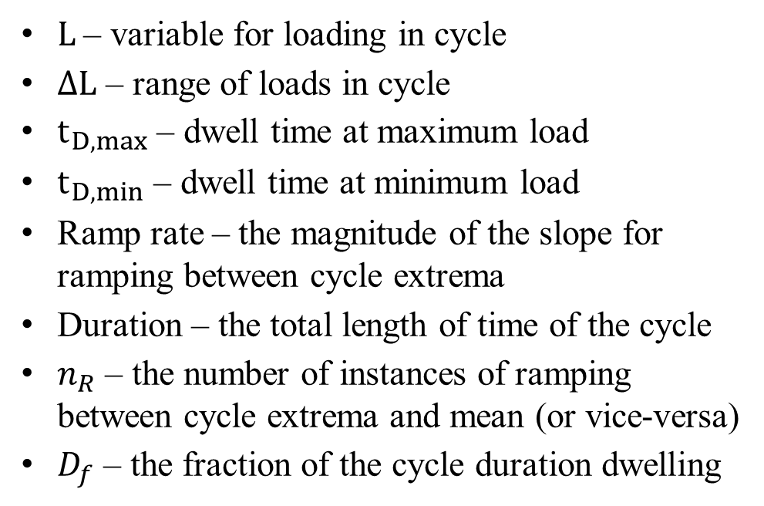

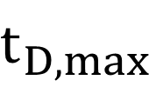
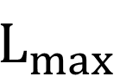
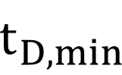

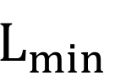
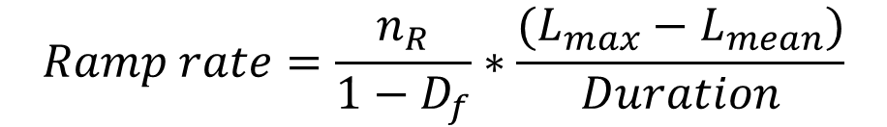
Example of a Load Cycle
L
$L$ – variable for loading in cycle
$∆L$ – range of loads in cycle
$t_{D,max}$ – dwell time at maximum load
$t_{D,min}$ – dwell time at minimum load
Ramp rate – the magnitude of the slope for ramping between cycle extrema
Duration – the total length of time of the cycle
$n_{R}$ – the number of instances of ramping between cycle extrema and mean (or vice-versa)
$D_{f}$ – the fraction of the cycle duration dwelling
Duration
$$t_{D,max}$$
$$L_{max}$$
$$L_{mean}$$
$$∆L$$
Ramp rate
$$L_{min}$$
$$t_{D,min}$$
Equation for calculating ramp rate (if not otherwise specified):
$$Ramp rate=\frac{n_{R}}{{1−D}_{f}}∗\frac{(L_{max}−L_{mean})}{Duration}$$
Time

Slide 32
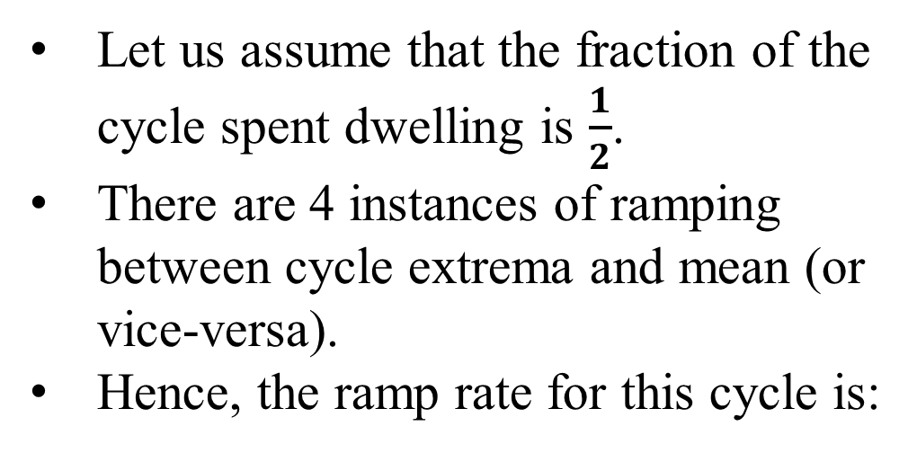
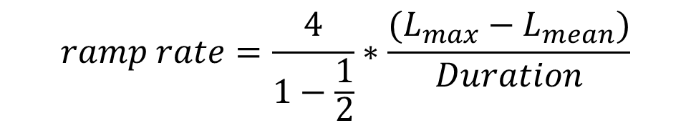
Example of Load Cycle Ramp Rate Calculation
Load
Duration
Let us assume that the fraction of the cycle spent dwelling is $\frac{1}{2}$.
There are 4 instances of ramping between cycle extrema and mean (or vice-versa).
Hence, the ramp rate for this cycle is:
$$t_{D,max}$$
$$L_{max}$$
1
2
$$L_{mean}$$
$$∆L$$
Ramp rate
3
4
$$ramp rate=\frac{4}{1−\frac{1}{2}}∗\frac{(L_{max}−L_{mean})}{Duration}$$
$$L_{min}$$
$$t_{D,min}$$
Time

Slide 33
Temperature Cycle Extraction Module (calceTCExtractor)
The CALCE Simulation Assisted Reliability Assessment package includes the ability to extract temperature cycles from raw temperature measurements.
This functionality is demonstrated using the charted data. It is assumed that the function presented by this data repeats throughout the day.

Slide 34
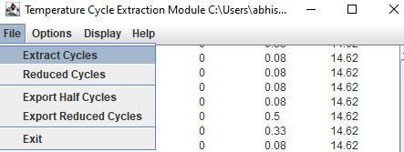
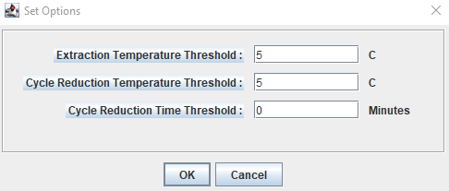
calceTCExtractor Cycle Extraction Options
Clicking Extract Cycles and selecting a .csv containing the raw temperature data, calceTCExtractor identifies individual cycles in the data.
Navigating to Options, one can filter out extracted cycles based on:
Cycle temperature range (“Extraction Temperature Threshold”)
How similar cycles are to each other in temperature or duration (“Cycle Reduction Temperature/Time Threshold”)

Slide 35
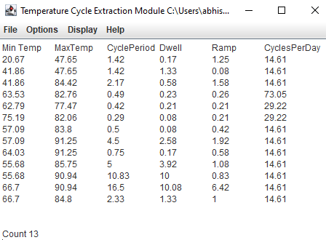
Temperature Cycles Extracted from Raw Temperature Data
The calceTCExtractor separated the data into 13 individual cycles, with different cycle parameters and how many times each cycle occurs every day.

Slide 36
Extracted Cycles Graphically Represented
Using the previously defined cycle parameters, one can plot the cycles by exporting the cycle parameters out of the software.
Due to cycle filtering, the low temperature range cycles are removed and not exported out.

Slide 37
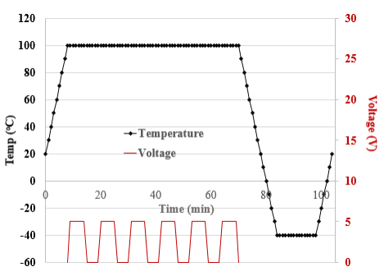
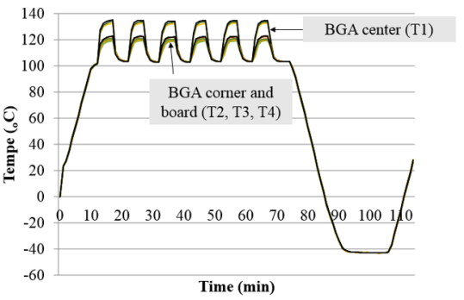
Other Examples of Variations in Temperature Cycles
Center of Circuit Card Assembly
Corner of Circuit Card Assembly
Temp (°C)
Temp (°C)
Time (min)
Time (min)
Different Maximum and Minimum Temperature Dwell Times
Differences in Localized Temperature Cycling
F. Chai, Solder Interconnect Life Prediction Under Complex Temperature Cycling with Varying Mean and Amplitude [PhD Dissertation], College Park, Maryland: University of Maryland, College Park, 2013.

Slide 38
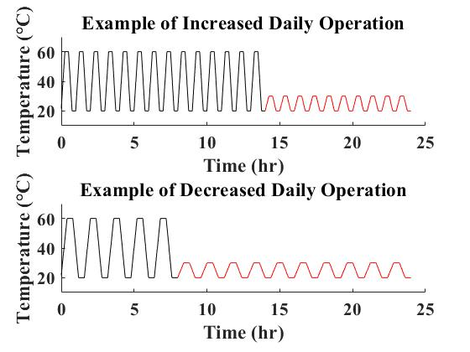
Variations in Operation Cycles in Similar Applications
The same product can be used for different, but related end uses. Some examples of these could include:
A washing machine for a single-family household versus a laundromat.
Both short-haul and long-haul trucks could use the same engine control module.
Ultimately, the load cycles would be the same, but the number of cycles in the product lifetime would increase or decrease depending on the application.
Operation
Non-operation
Operation
Non-operation

Slide 39
Prioritization of Failure Mechanisms
Identify Potential Failure Mechanisms
Using information about the product design and the life cycle profile, prioritize the failure mechanisms for the product in its intended application.
Evaluate Potential for Failure Due to Each Failure Mechanism
Assign Severity of Failure Due to Each Failure Mechanism
Prioritize Failure Mechanisms Based on Potential and Severity of Failure
Procedure for prioritizing failure mechanisms
K. C. Kapur and M. Pecht, Reliability Engineering, A. P. Sage, Ed., Hoboken, NJ, USA: John Wiley & Sons, Inc., 2014.

Slide 40
Examples of Failure Mechanisms and Models
Failure Mechanism | Failure Sites | Relevant Stress Parameters | Failure Models
Fatigue | Die attach, Wire-bond / Tape Automated Bonding, Solder leads, Bond pads, Traces, Vias / Plated Through Hole, Interfaces | Cyclic deformations (temperature, humidity, or voltage cycling) | Nonlinear Power Law (Coffin-Manson)
Corrosion | Metallizations | Moisture, voltage cycling, temperature, chemicals | Eyring (Howard)
Electromigration | Metallizations | Temperature, current density | Eyring (Black)
Conductive Filament Formation | Between Metallizations | Moisture, voltage gradients | Power Law (Rudra)
Stress Driven Diffusion Voiding | Metal Traces | Stress, temperature | Eyring (Okabayashi)
Time Dependent Dielectric Breakdown | Dielectric Layers | Voltage, temperature | Fowler-Nordheim

Slide 41
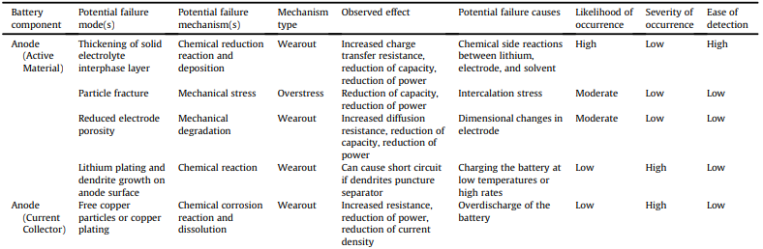
Examples of Failure Mechanism Prioritization for a Lithium-Ion Battery Anode
C. Hendricks, N. Williard, S. Mathew and M. Pecht, “A Failure Modes, Mechanisms, and Effects Analysis (FMMEA) of Lithium-Ion Batteries,” Journal of Power Sources, vol. 297, pp. 113-120, 2015.

Slide 42
Improving Future Product Design Using the Life Cycle Profile and Critical Failure Mechanisms
Product degradation due to the critical failure mechanisms and life cycle profile conditions represents product vulnerabilities.
Future product design should eliminate these vulnerabilities to improve product reliability.
Consider the example of using the canopy to improve Washington D.C. escalator reliability.

Slide 43
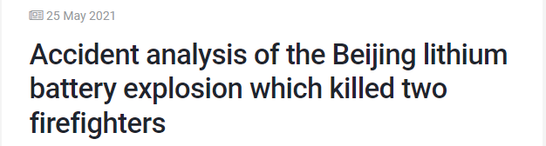
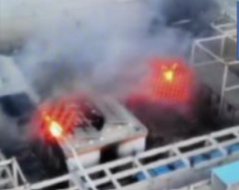
Consequences of Ignoring Potential Life Cycle Loads
The authorities believe that sand and dust contamination due to dust storms contributed to battery insulation breakdown.
The battery insulation breakdown itself led to an electrical short and thermal runaway, starting the fire.
Accident Analysis of the Beijing Lithium Battery Explosion which Killed Two Firefighters, International Association for Fire and Rescue Services, 2021.
URL: https://www.ctif.org/news/accident-analysis-beijing-lithium-battery-explosion-which-killed-two-firefighters

Slide 44
Closing Observations
Development of the life cycle profile is absolutely necessary and should not be ignored.
The success of products and the reputation of companies depend on the life cycle profile.
Failure to account for the life cycle profile can have severe consequences, including death.

